Slide 1
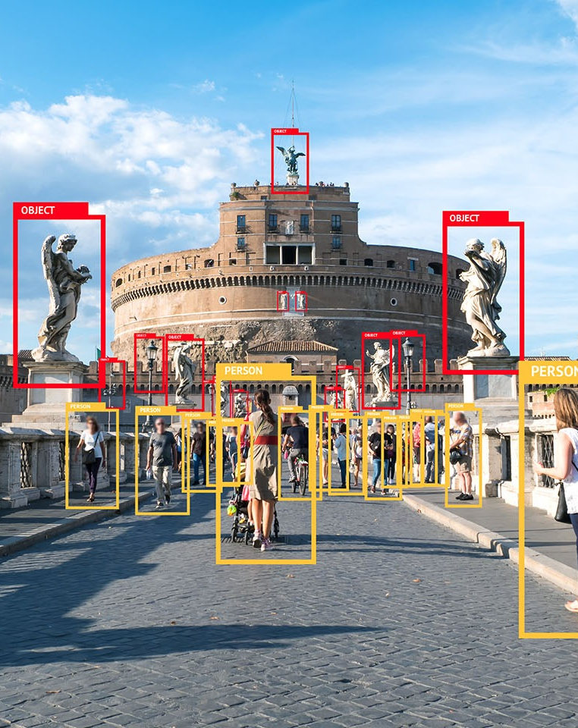
Object Detection & Optical Character Recognition
M A C H I N E L E A R N I N G
I M A G E P R O C E S S I N G

Slide 2
Agenda
Object Detection
Optical Character Recognition
Applications of OCR
License Plate Recognition
Technologies Used
Modules & Description
Applications

Slide 3
Object Detection
Aspect of Computer vision
Refers to the capability of the computer to detect and identify objects
Widely used for face detection, vehicle detection, pedestrian counting, web images, security systems and driverless cars

Slide 4
Optical Character Recognition (OCR)
Recognizes text within a digital image
Electronic conversion of images of typed, handwritten or printed text into machine-encoded text
Widely used as a form of information entry from printed paper data records

Slide 5
Applications of OCR
Digitization of data from standardized documents such as Aadhar cards and PAN Cards
Automation of image to text conversion of application forms and agreements
Banking sector to process cheques
Healthcare to process large amount of forms
Digitize paper work in government offices

Slide 6
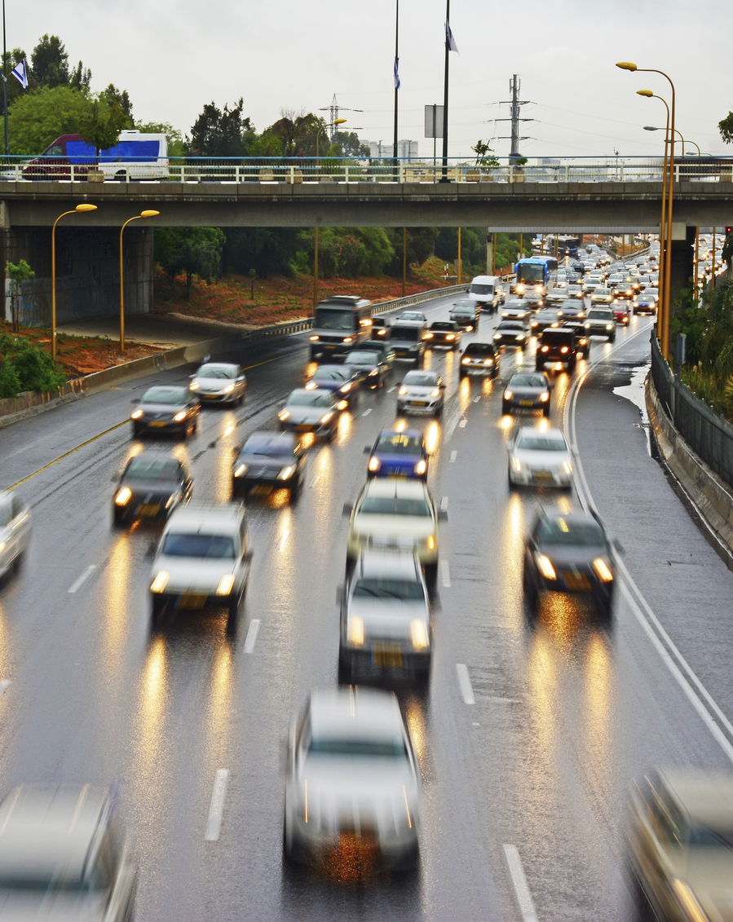
License Plate Recognition
Notes:
To change the image on this slide, select the picture and delete it. Then click the Pictures icon in the placeholder to insert your own image.

Slide 7
Problem Statement
To develop a License Plate Recognition (LPR) model using machine learning and image processing.

Slide 8
Use case
Car arrives at the gate.
Camera clicks the picture of the car
Detects the license plate
Obtains the license number
If authorized, the gate is opened.

Slide 9
Introduction
Detection and extraction of characters from the number plate
Use of Optical Character Recognition
Techniques of Image Processing and Machine Learning

Slide 10
Technologies Used
Image Processing –
Image segmentation
Threshold based (OTSU Binarization)
Region based (CCA)
Machine Learning –
Character Recognition
Classification using SVM (Support Vector Machine)

Slide 11
Modules
License Plate Recognition
License Plate Detection
Character Segmentation
Character Recognition

Slide 12
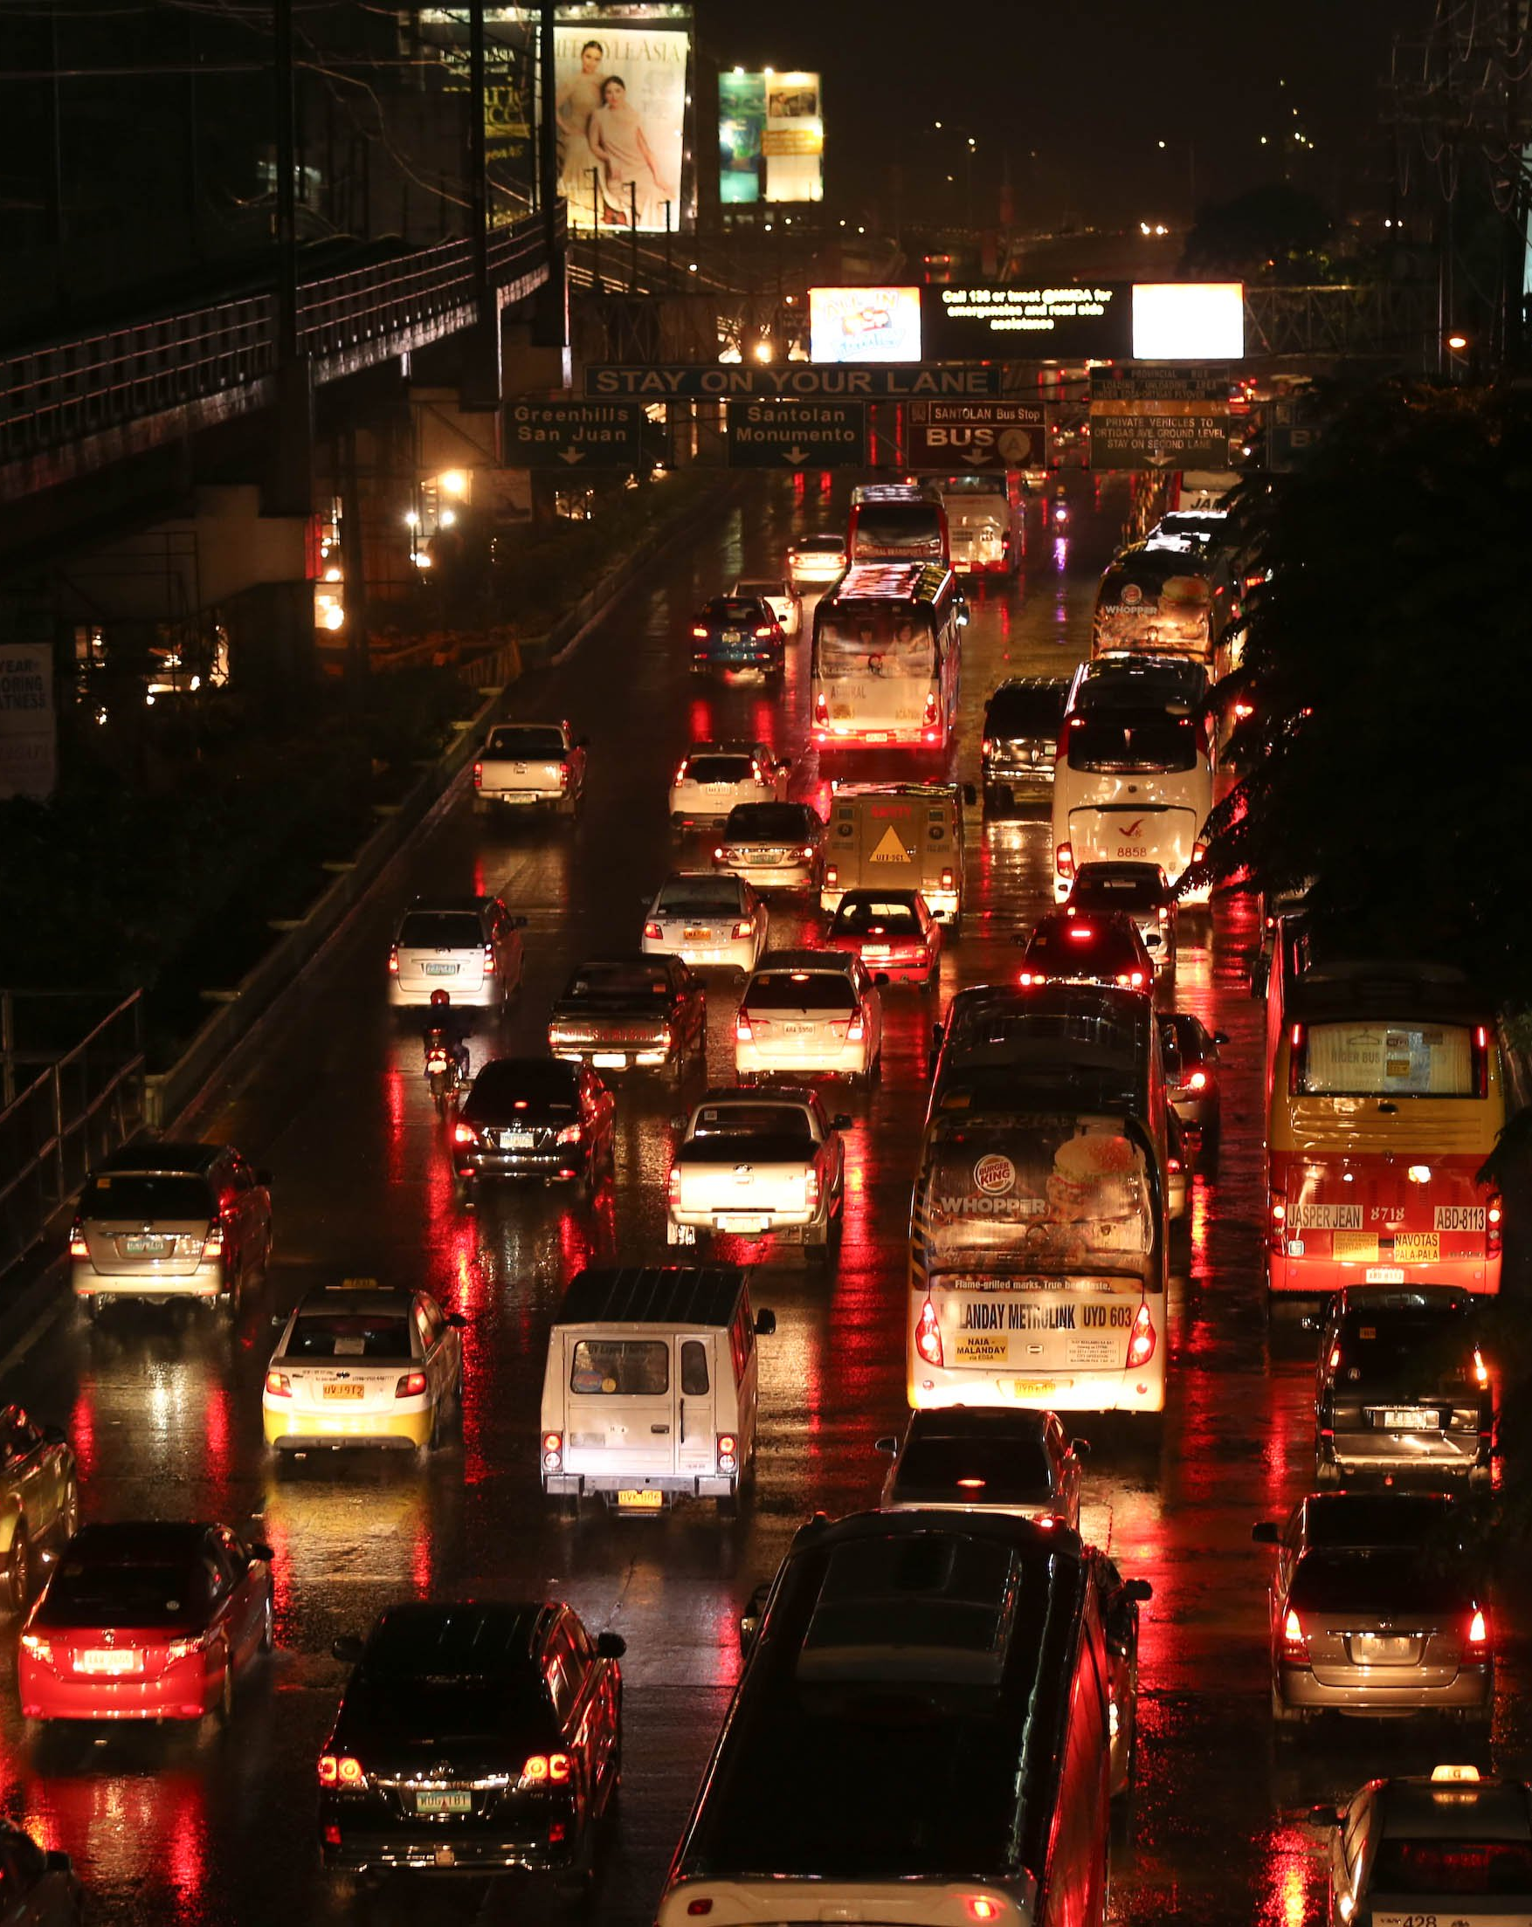
Number Plate Detection
Module - 1

Slide 13
Plate Detection
Converting to Gray-scale
OTSU Binarization
Reading the image
Connected Component Analysis
Extracting the License Plate

Slide 14
Gray Scale Conversion
Value of each pixel represents the brightness and intensity information
Discards the RGB values for each pixel
Converts a 3D image to 2D image

Slide 15
OTSU Binarization
Reduction from gray scale image to binary image
Assumes that the image contains two classes
Automatic calculation of an optimum threshold value
Pixel will be either black or white

Slide 16
Connected Component Analysis
Clusters of pixels with the same values connected to each other
Connected components share similar pixel intensity values
Works on binary and gray scale images
Scans an image, pixel-by-pixel

Slide 17
Character Segmentation
Module - 2

Slide 18
Segmentation
License Plate Image
Inverting the image
Connected Component Analysis
Segmented Characters

Slide 19
Inversion
Complementary image
Inversion of white pixel to black pixel i.e. true values to false and vice versa
Gives scope to clear disturbances in the region of interest

Slide 20
Character Recognition
Module - 3

Slide 21
Recognition
Segmented image
Model Training using SVC
Prediction of Characters

Slide 22
Model
Implemented over a classification algorithm Support Vector machine
Training dataset is used to train the SVC model
4-cross validation to determine the accuracy
Trained model is saved as pickle file

Slide 23
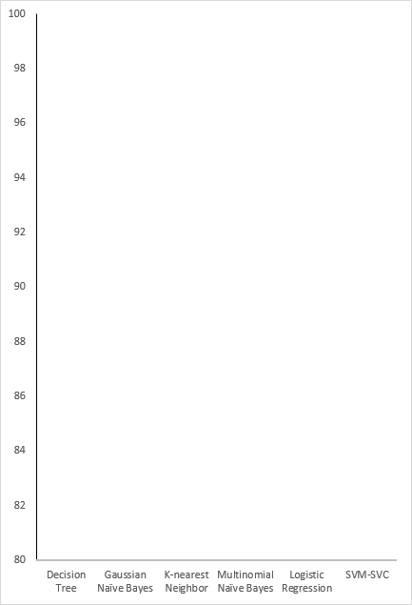
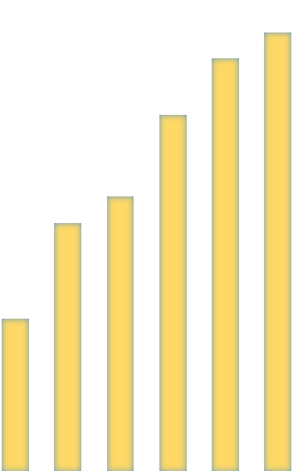
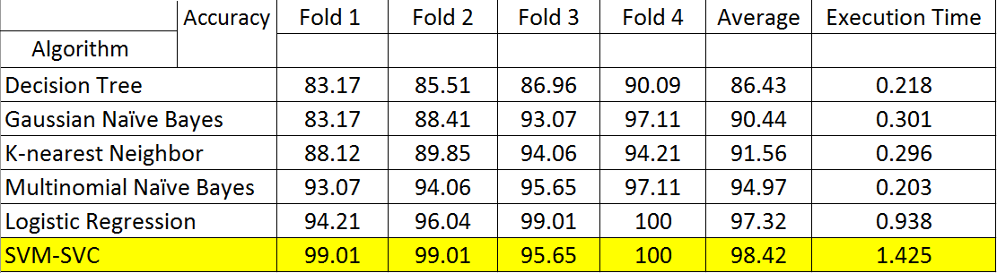
98.42
97.32
94.97
4 Fold Cross Validation Scores
91.56
90.44
86.43

Slide 24

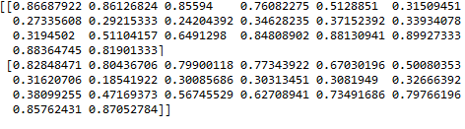

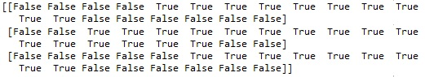
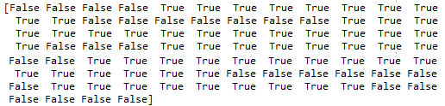
Original Image
2D numpy array of Image
Binary Image
2D array of Binary image
Reshaped 1D array of Binary image

Slide 25
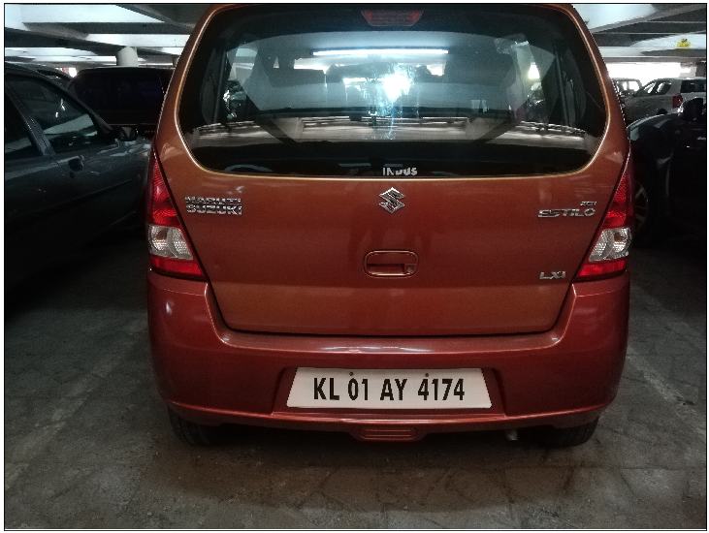
Original Image

Slide 26
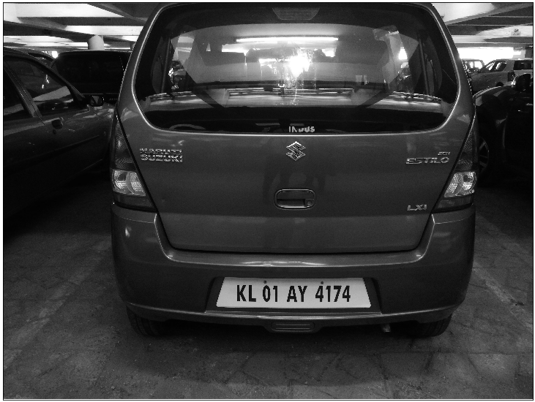
Original to Grey Scale

Slide 27
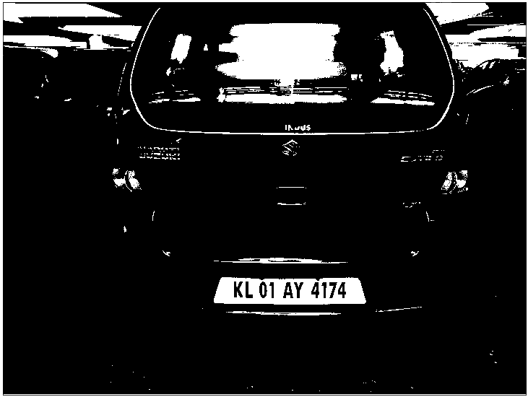
Gray scale to Binary

Slide 28
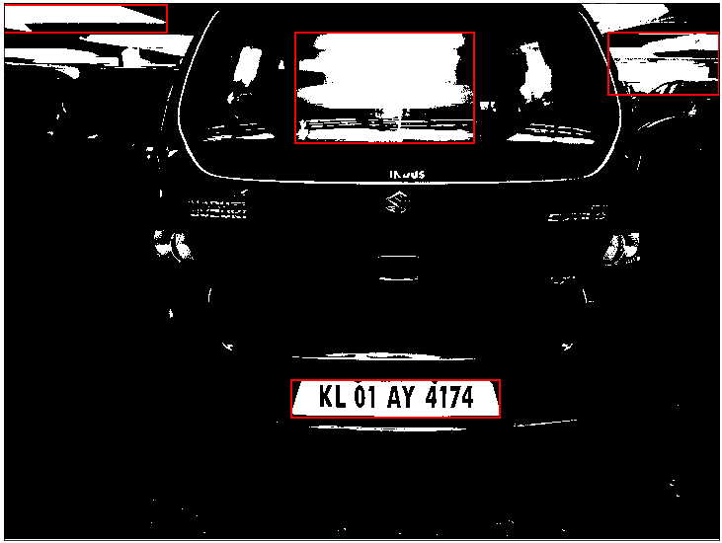
Binary to CCA

Slide 29
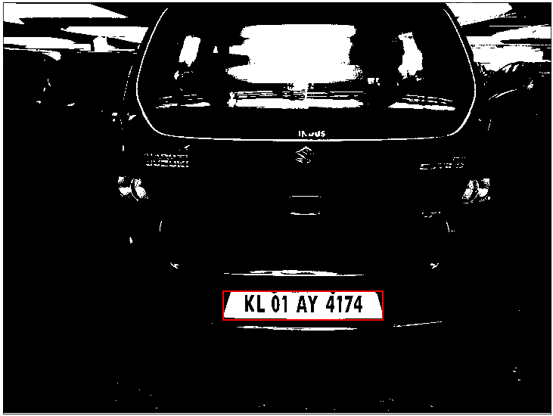
CCA to Plate Detection

Slide 30


Inverting Image

Slide 31

CCA in number plate

Slide 32
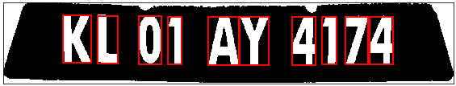
Labelled Number plate

Slide 33
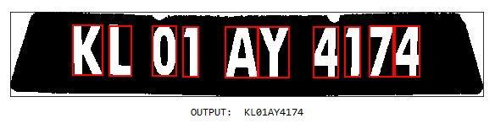
Prediction

Slide 34
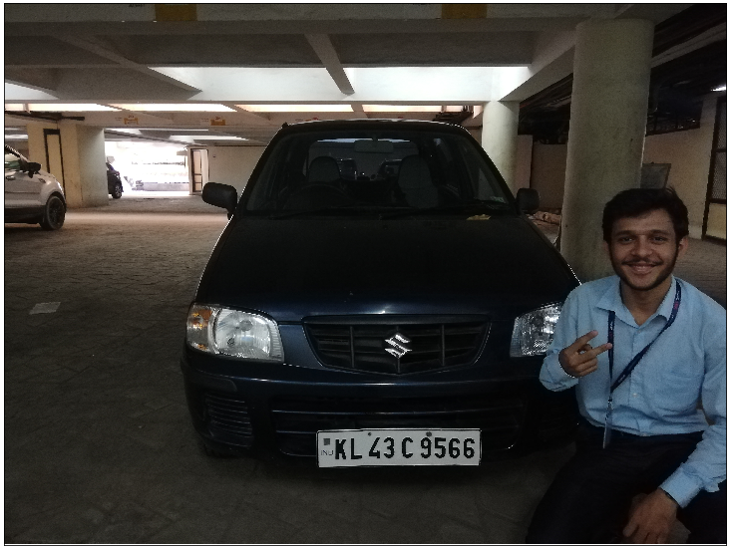
Visualization

Slide 35
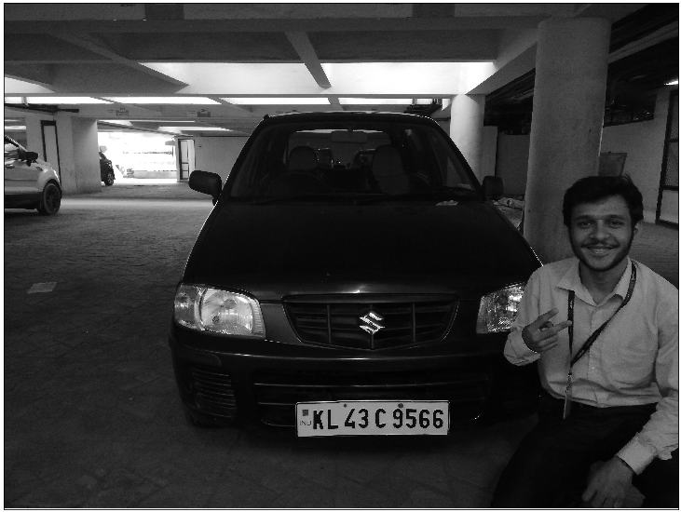

Slide 36
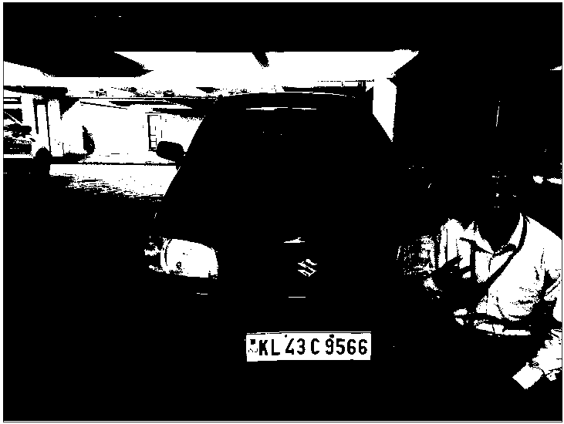

Slide 37
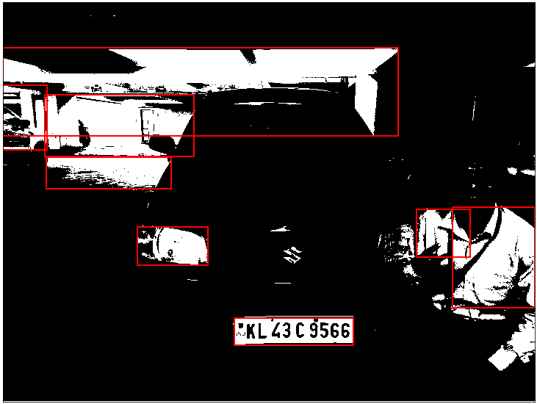

Slide 38
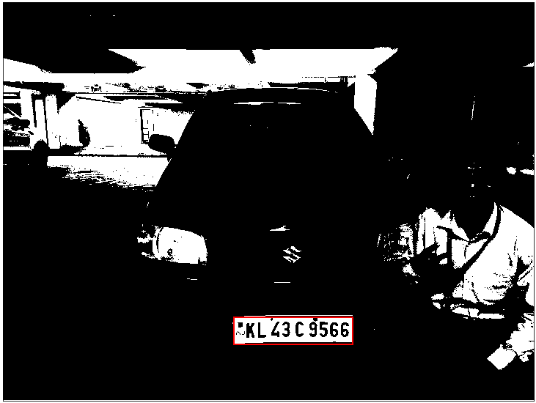

Slide 39
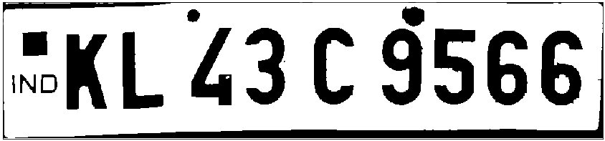


Slide 40
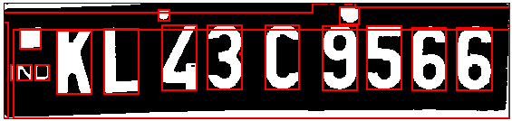
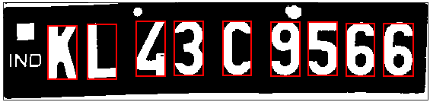

Slide 41


Slide 42
Applications
Ensure authenticity at parking zones in organizations
Security in high restricted areas such as military zones and government offices
Reduce Speed enforcement on roads
Journey time measurement
Red light enforcement

Slide 43
Thank you! ☺

